Slide 1

Lecture 5: Recurrent Neural Networks and sequential problems
McGill Artificial Intelligence Society

Slide 2
Announcements
INSERT ANNOUNCEMENTS HERE
Research Talks
Monday, February 18 (17:30-19:00) at Trottier 1030
Assignment 5
Deliverable
???

Slide 3
Today’s Lesson Plan
Recap of feed-forward neural networks
What kind of problems can vanilla NNs not solve?
Recurrent Neural Networks
Vanishing gradient problem
Long Short Term Memory
Demo

Slide 4

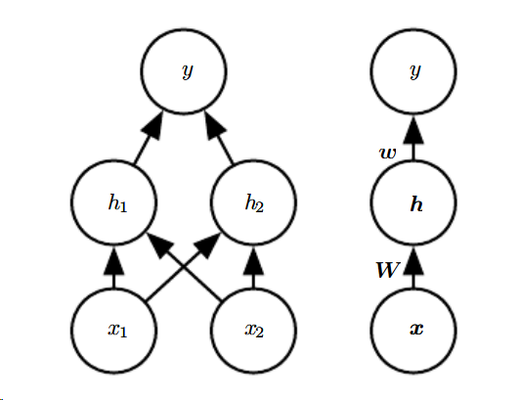
Recap: Feed-forward Neural Networks
Output of a single hidden layer neural network with rectified linear activation.
RHS is condensed version of LHS.
Why is it called feed-forward?
Taken from http://www.deeplearningbook.org/contents/mlp.html
Notes:
As a short recap for vanilla NNs, recall the structure of neural networks:
Input x
first weight matrix is W (plus the bias term of the first weights c)
relu applied (max{...})
second layer of weights w (plus bias of second layer, b)
final output y
Universal function approximator
(Ask the class) What problems can vanilla feed-forward neural networks NOT solve?

Slide 5
Shortcomings of non-sequential neural networks
No notion of “time” in a vanilla neural network
fixed length input/output
Notes:
Two gaps in the domain of vanilla neural networks
First, the order in which we input our features doesn’t particularly matter. Why doesn’t it matter? (give example of MNIST - you could reverse or changed ordering of the flattened input for every input picture, and as long as the order of each pixel stays the same for every input your neural network would still work
Second, your inputs and outputs are fixed length. What if I wanted to do language translation? input size != output size, how would I go about training something like this?

Slide 6
Solution: Recurrency and sharing parameters
In vanilla neural network, each input has its own parameter (elements of W).
“I went to Nepal in 2009” and “In 2009,I went to Nepal.”
Every input (word) has its own weight
Recurrent neural network shares weights across multiple time steps
Refer to inputs of a sequential problem as x_t, with t being the time-step index from 1 … T.
:
Notes:
Each feature has its own parameters. How would we parse a sentence like this?
RNNs share weights across each time step
Problems we deal with have the form x^(t). While t is called the time step index, it could refer to any “step” index for any sequential input.

Slide 7
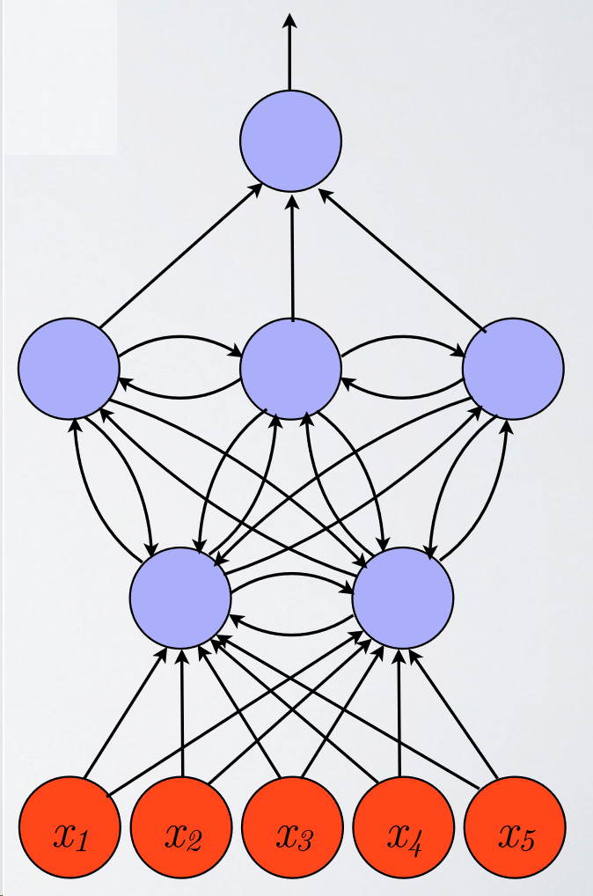
Recurrency and Cycles
What does recurrency and cycles in our computation graph allow us to do?
Keep internal state throughout time steps
Allow us to work with time-series data
Capture oscillatory patterns
Ignore parts of input sequence

Slide 8
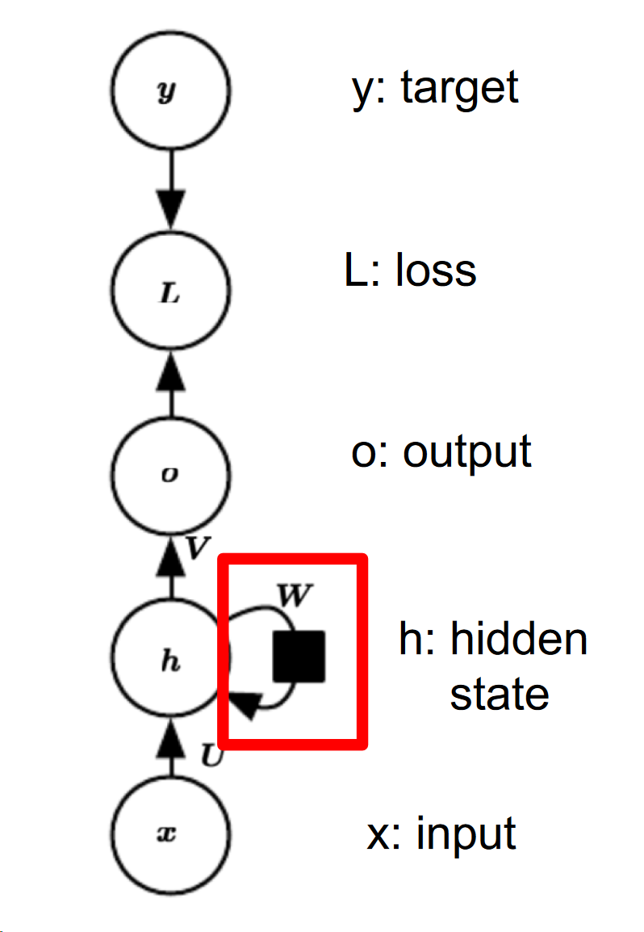
How do we incorporate a sequential flow of information?
What kind of cycles do we use?
Time delay cycles - information from this state is sent to next state
There is a “remembered” state that is passed forward in the sequence. We call this the hidden state of an RNN (h_t).
We can use h_t as input into some downstream model (ie. for machine translation, distribution over target dictionary)
Slide adapted from Herke Van Hoof’s - COMP 551 Lecture 13 on Dimensionality Reduction
Notes:
We have time delay cycles in our computational graph. When we mean cycle we mean a cycle with a time delay - pass the message forward.

Slide 9
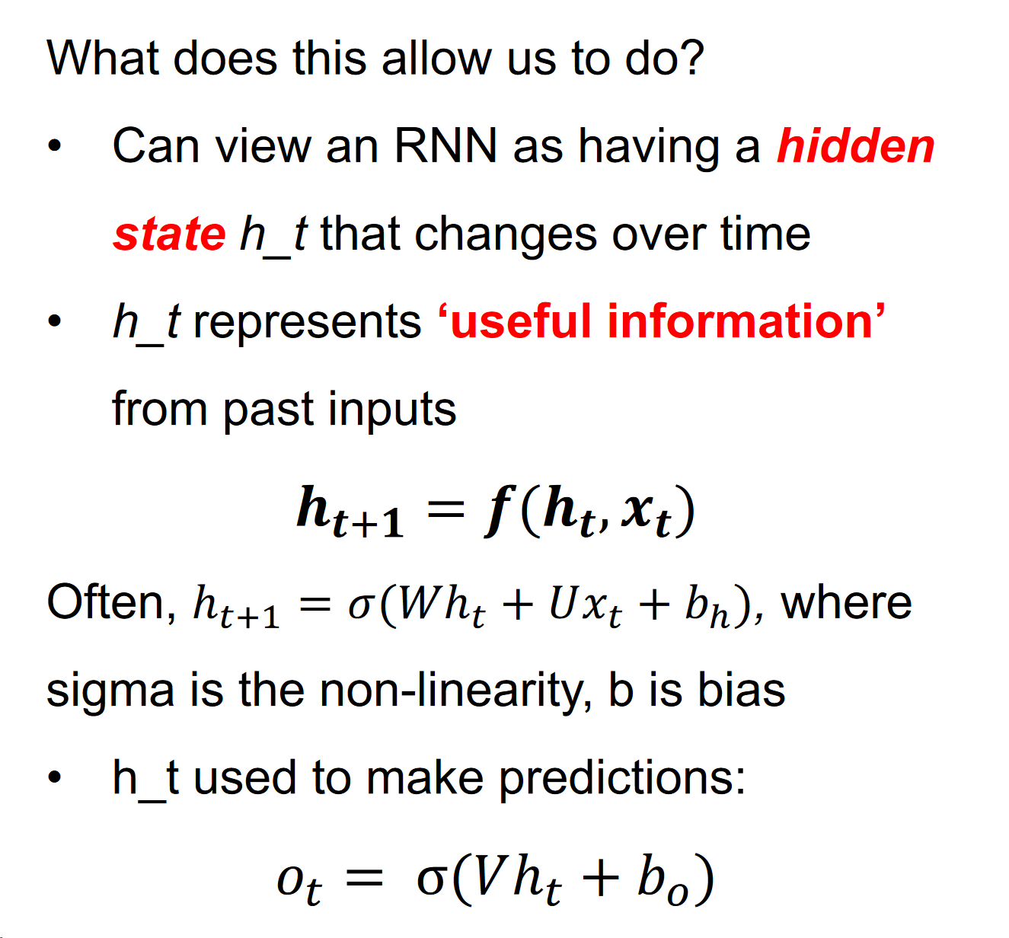
RNNs continued.
Taken from Ryan Lowe/Joelle Pineau’s COMP 551 slides

Slide 10
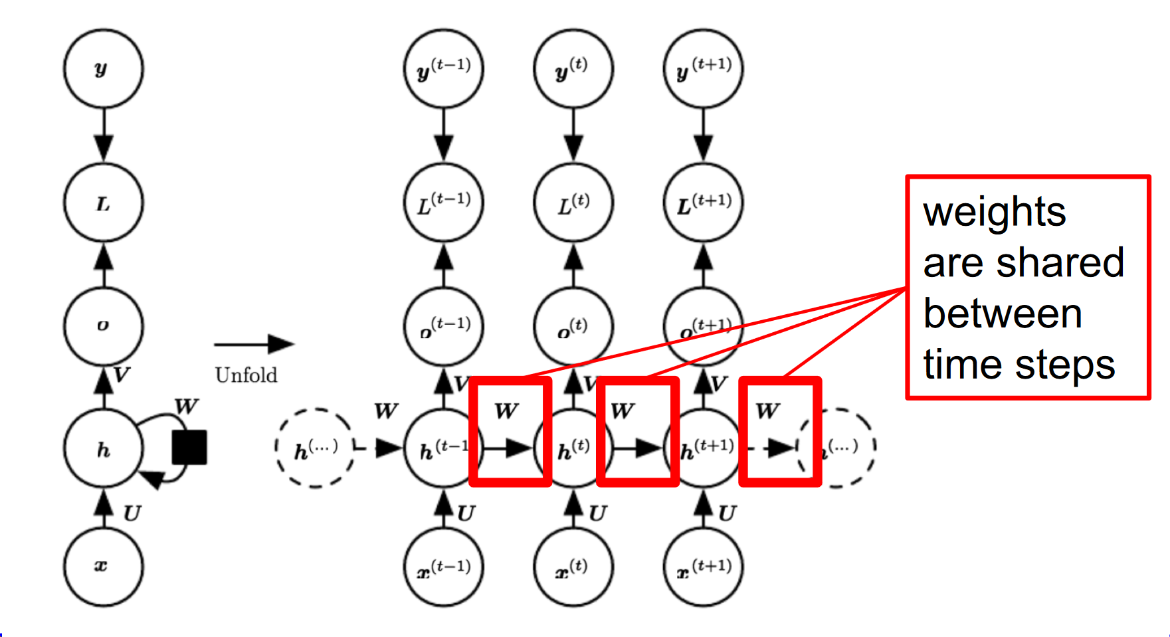
Unfolding the computational graph
This is actually what’s happening during an RNN computation - we continually predict the next hidden state, and use this for predictions. But how do we train this model?

Slide 11
How do we train RNNs?
Same as feed-forward networks, we use back-propagation on our “unrolled” computation graph.
Use chain rule to calculate partial derivatives
SAME as feed-forward neural networks! We call this Backpropagation through time (BPTT).

Slide 12
Problem with long-term dependencies
Example: Language modelling.
“I grew up in France, [long sentence here], I speak fluent ____” -> Trying to predict next word.
In practice - very hard for RNNs to learn long-term dependencies.
Why is this?

Slide 13
Problem with long-term dependencies cont.
Remember: transition between hidden states uses the same weight w for all time steps.
Can cause gradients to either explode or vanish - imagine multiplying a scalar by itself n number of times. What happens? Similarly with matrices!
If you’re interested in eigendecomposition view on this, check out the 551 slides here:
Notes:
The closed form solution has to do with what we call our covariance matrix, notated as sigma. We’ll be talking about the eigenvectors and eigenvalues of this matrix.
So what is this covariance matrix? Let’s take a step back and talk about variance. Variance, as we saw in the Gaussian distribution, was related to standard deviation, which provides a measure of how much the data is “spread” across the feature space. But what if we want to explain multiple variances, in 3D? Or just in general, in higher dimensions?
Consider the 2D space in the top-left corner of the slide.
For this data, we could calculate the variance in the x-direction and the variance in the y-direction. However, the horizontal spread and the vertical spread of the data does not explain the clear diagonal correlation. We can clearly see that on average, if the x-value of a data point increases, then also the y-value increases, resulting in a positive correlation. This correlation can be captured by extending the notion of variance to what is called the ‘covariance’ of the data.
For 2D data, we thus obtain sigma(x,x), sigma(y,y), sigma(x,y) and sigma(y,x). These four values can be summarized in a matrix, called the covariance matrix. As expected, a N x N covariance matrix captures the spread of N-dimensional data.
(Example of top left covariance matrix) Let’s take a read at the top left covariance matrix. (Slide)

Slide 14
Fixing vanishing/exploding gradients
Clip gradients:
if |gradient| > max_val :
gradient = value * sign(gradient)
More complex RNN architecture to include non-multiplicative interactions.
Notes:
So in this case, we have a data matrix X with n = 5, m =2. Ok so now we’ve defined our mean centered feature matrix Xbar, what can we do to compute our principal components?
As we saw in the previous slides, the covariance matrix defines both the spread (variance), and the orientation (covariance) of our data. So, if we would like to represent the covariance matrix with a vector and its magnitude, we should simply try to find the vector that points into the direction of the largest spread of the data, and whose magnitude equals the spread (variance) in this direction. So it turns out that this problem can simply be equated to computing the eigenvectors of our covariance matrix sigma (Slide)

Slide 15
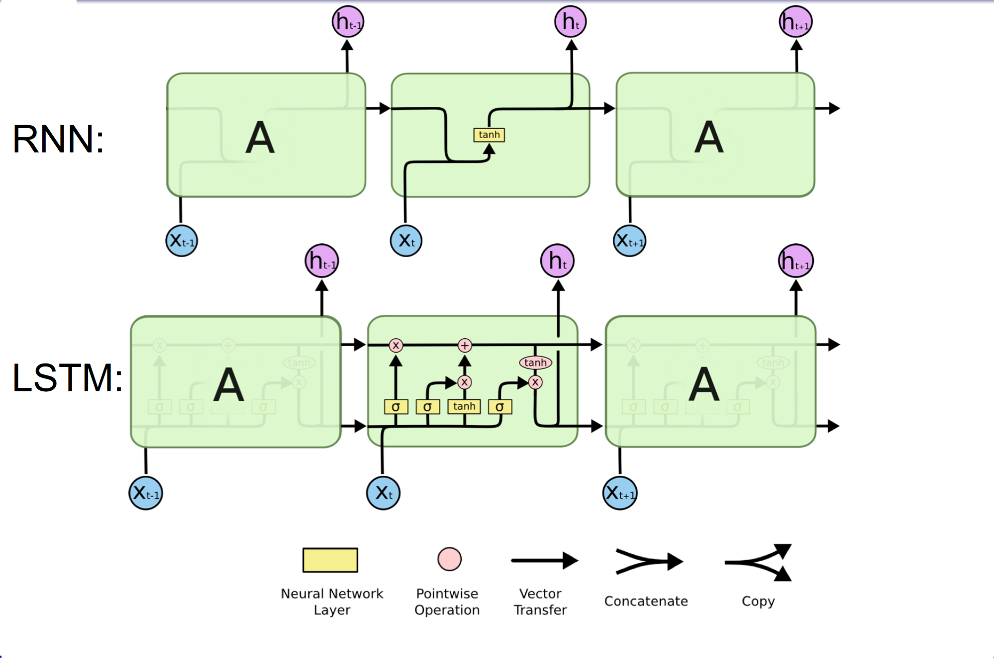
Long Short-Term Memory (LSTM)
Notes:
THis is gonna be so long and hard to explain ugh

Slide 16
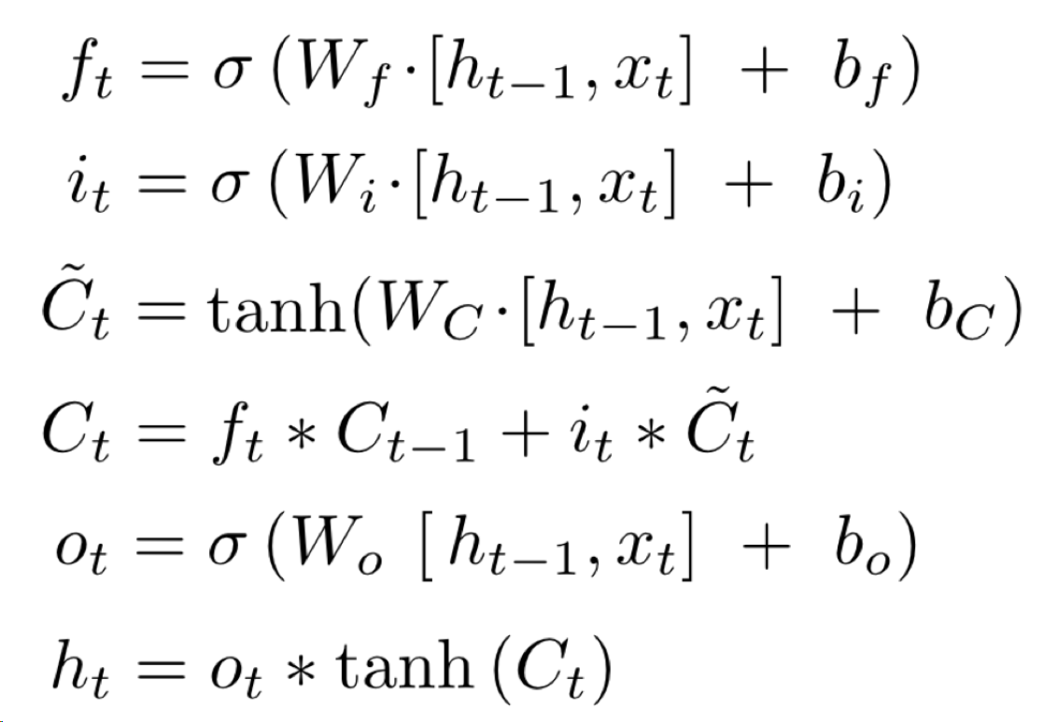
LSTM components
Governed by this set of equations below
Has two type of “states”, cell state and the previous hidden state we mentioned
Slides 16-21 Taken from Herke Van Hoof’s COMP551 Slides Lecture 13 - Dimensionality Reduction

Slide 17
LSTM components cont.
Still interested? For a more in-depth explanation of RNNs and LSTMs check out:
https://colah.github.io/posts/2015-08-Understanding-LSTMs/
What are some things we can do with RNNs?

Slide 18
5 minute break

Slide 19
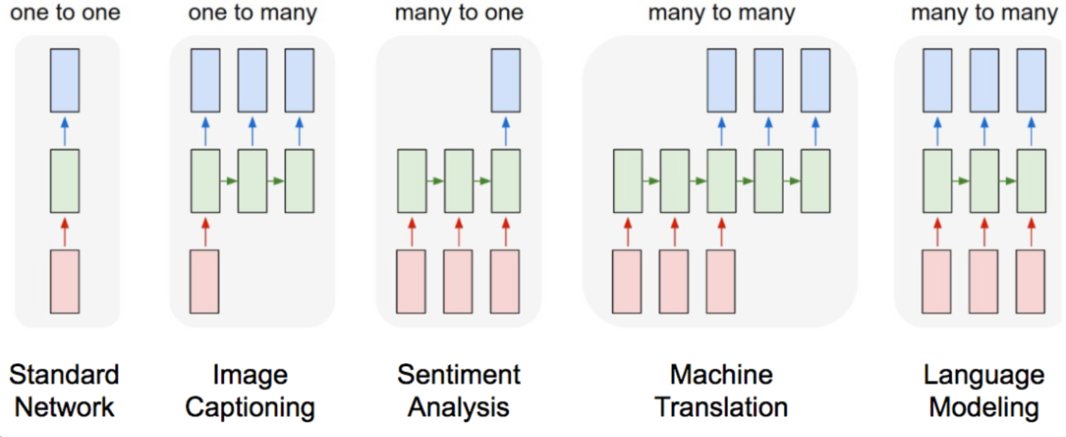
How do we apply this to a downstream task?
Sequential nature of RNNs allow us to apply it to many tasks, for example...

Slide 20
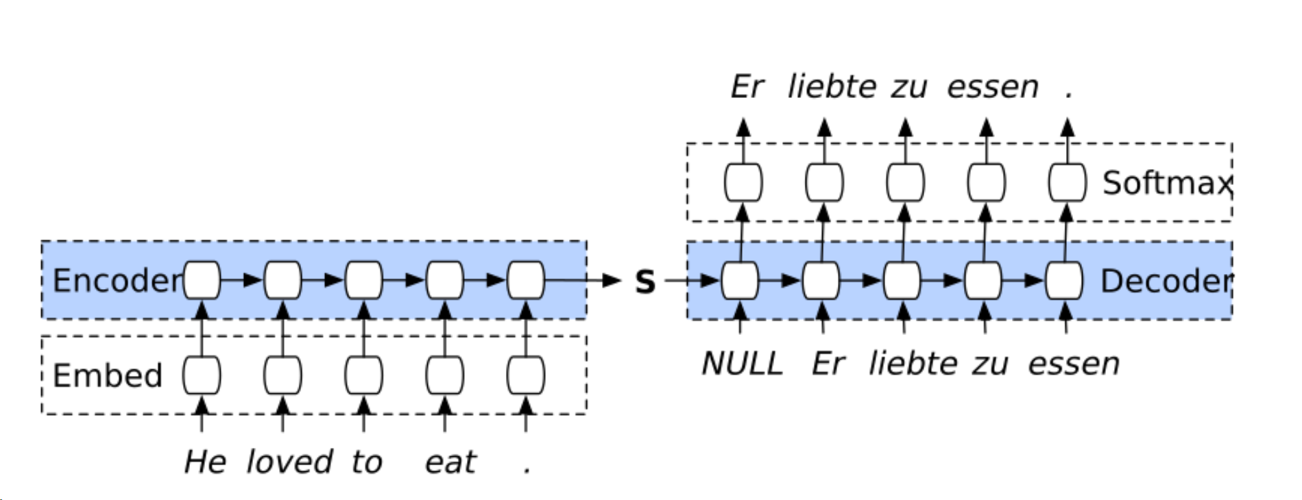
Sequence to sequence models
One of the most popular approaches towards sequential data are Sequence to Sequence (Sutskever et al, 2014.) models.
Follows an encoder-decoder architecture.

Slide 21
Encoders with RNNs
Representation learning for sequences
Builds a representation of input sequence with the hidden state.
First embeds each input from a word index into something in R^n, where n is embedding size.
Sequentially takes in input and has a final “representation” of entire sentence in final hidden state.
How could we encode variable length sentences?
h_0
h_1
h_2
h_3
h_4 = S

Slide 22
What’s a word embedding?
Vector representations of a certain word.
Used for capturing context. Why do we need them?
ie. “have a good day” vs “have a great day” - barely any difference in meaning.
We can map each word in the combined vocab into the following dictionary:
0 = have, 1 = a, 2 = good, 3 = great, 4 = day
One-hot encodings of each will tell us that (in terms of euclidean distance) have and day are as dissimilar as great and good - which is not true!
We need a way of capturing similarity in vector space!

Slide 23
Word embeddings cont.
We do this with multiple methods
frequency based methods (how often does a word show up in this set of documents? or similar words appear close to each other)
prediction based methods (solve the prediction problem of given a context, predict a word / given a word, predict a context, then use the weights)
Allows us to do cool things in embedding space like
embed(king) - embed(man) + embed(woman) = embed(Queen)
If you’re interested in learning more about embeddings, check this out:
https://www.analyticsvidhya.com/blog/2017/06/word-embeddings-count-word2veec/
Notes:
Before getting into the math behind it, let’s take a quick look at PCA does visually! (Slide)

Slide 24
Back to seq-to-seq
Now that we have representations of each word, we feed those in to an RNN to find a combined representation of the entire sentence.
How do we use this to “decode” the input sentence into another language?
Notes:
Before getting into the math behind it, let’s take a quick look at PCA does visually! (Slide)

Slide 25
Decoders
We use this representation of our sentence to output a probability distribution over our target vocab
We pick the max of this distribution as the output
And feed this output (or maybe not???) as the input to the next step
How do we generate variable length sequences?
Notes:
Before getting into the math behind it, let’s take a quick look at PCA does visually! (Slide)

Slide 26
RNN Demo
Notes:
So now, we’ll be taking a look at an application of PCA, called eigenfaces.

Slide 27
Extensions
Encoding entire translated sequence from one vector - super impressive!!!
This doesn’t really work in practice too well…
while LSTMs help with the vanishing gradients problem, it’s still very hard to remember context from so long ago
It would be nice if at every step we could see all the previous encoded words and do something with those hidden states….
Notes:
Potential: Certain datasets are clearly one-dimensional, yet PCA will fail! (Huh what)
Q: For this specific dataset, what’s the single axis for which all data points could be projected onto?
A: We could project the data points onto an axis theta, for which each value of theta would correspond to the angle that the vector from the origin to the datapoint forms.
Since this mapping is clearly non-linear, PCA cannot learn the appropriate projection onto a good linear subspace.
Q: What can we use to learn non-linear functions instead? (Ask class) (Slide)

Slide 28
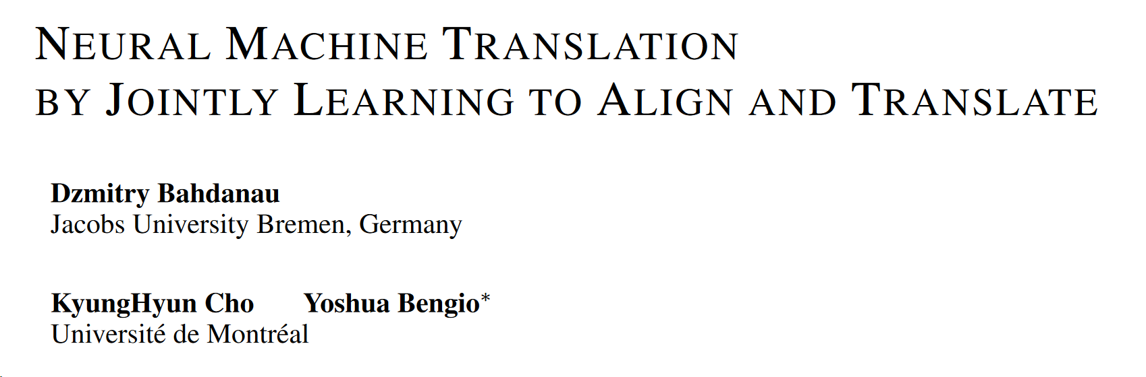
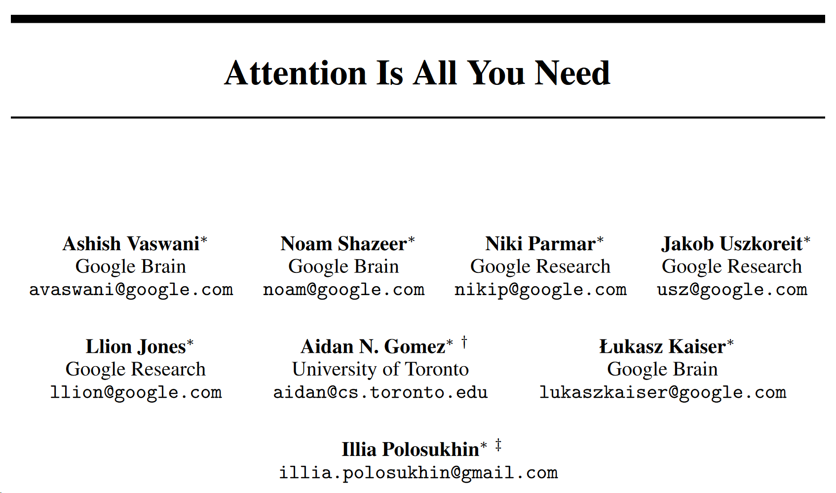
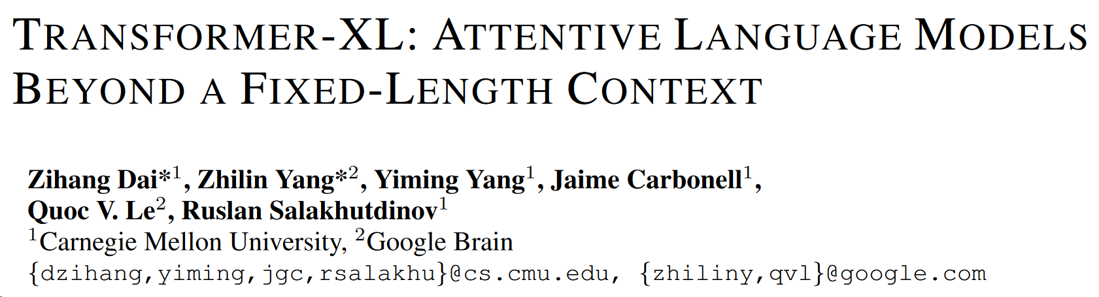
Attention mechanisms
Use all previous hidden states to predict decoded output at timestep t.
2014 -
2017 -
2018 -
MORE attention and MORE parameters == BETTER performance!!!
If you’re interested check out the papers!
Notes:
Luckily, neural networks can learn arbitrary, non-linear functions! This is where autoencoders come in.
Autoencoders are a special neural network architecture, and fall under the realm of unsupervised learning. When do we want to use autoencoders?
Want to learn representations (features) of the data, but not sure for what task (falls under the realm of representation learning)
The features learned by autoencoders can provide extra data for supervised tasks
When we learn features in a smaller dimension space, we could even cluster our data more efficiently, or even visualize our data if in R^3 or less.
So, what’s the main idea behind autoencoders? Learn the identity function with a bottleneck!
The idea is to design a neural network architecture such that we impose a bottleneck in the network. This bottleneck (show on slide), forces a compressed knowledge representation of the original input. If the input features were each independent of one another, this compression and subsequent reconstruction of the “original” input would be a very difficult task. However, if some sort of structure exists in the data (ie. correlations between input features), this structure can be learned and consequently leveraged when forcing the input through the network's bottleneck.

Slide 29
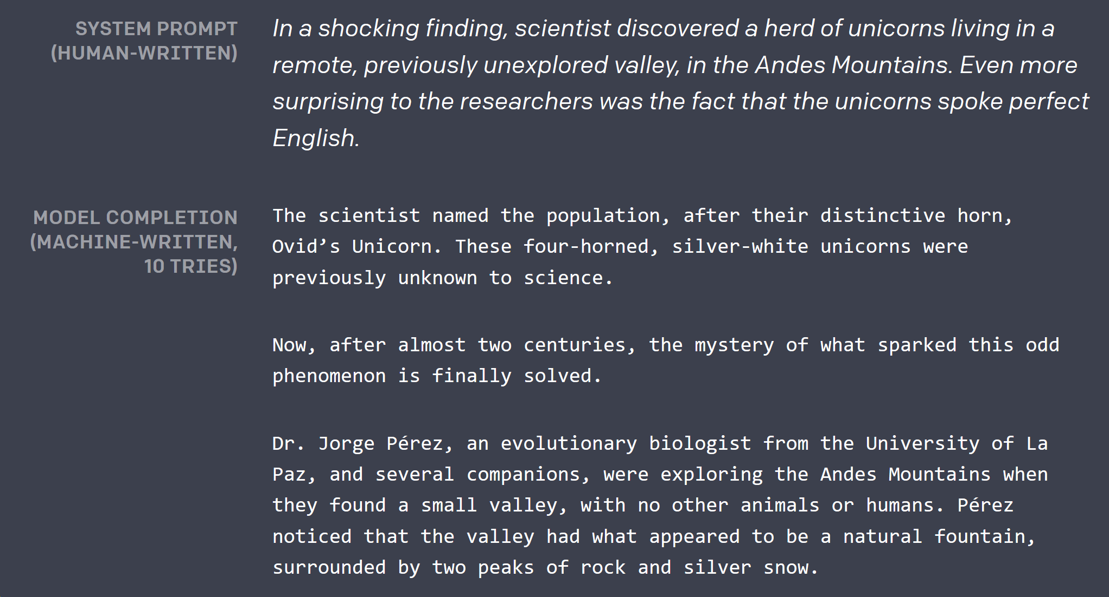
Where do current NLP models fail?
It seems like state of the art language models do very well in certain tasks!
One big area where modern NLP (and deep learning in general) fails - common sense reasoning.
Winograd Schema Challenge
Taken from https://blog.openai.com/better-language-models/
Notes:
As visualized above, we can take an unlabeled dataset and frame it as a supervised learning problem tasked with outputting x^, a reconstruction of the original input x. This network can be trained by minimizing the reconstruction error, L(x,x^), which measures the differences between our original input and the consequent reconstruction. The bottleneck is a key attribute of our network design; without the presence of an information bottleneck, our network could easily learn to simply memorize the input values by passing these values along through the network (point to slides).
Note: In fact, if we were to construct a linear network (ie. without the use of nonlinear activation functions at each layer) we would observe a similar dimensionality reduction as observed in PCA. That is, for PCA, choosing the m’ eigenvectors of the covariance matrix of X would be similar to training an autoencoder with a single hidden layer and m’ hidden nodes. Keep in mind, that is assuming that the activation functions in the hidden units are linear.

Slide 30
Thanks!
Any questions?
Reminders:
Homework 4 Due next week!
Deliverable 2 should be submitted - Deliverable 3 due in 2 weeks!
Fill in feedback form (https://goo.gl/forms/GDhcRQUr5HmYfpNg2). We have quality feedback so far, but not a lot!

